Slide 1
Institute of technology of Cambodia Department of Applied Mathematics and Data Science
Lead by DR. CHAN SOPHAL
AMS-B Group 1 : CHHORN CHAINA
LENG MOUYHONG
HOK KIMLEANG
HONG KIMMENG
KHON YIN SAKAL

Slide 2
CONTENTS
01 General Introduction
The key details and some information related to this project.
02 Objective
Main goals and what is to be achieved by the project / Where are we directing?
03 Identifying Tasks
Specifics task needed to accomplish in order to complete the project.
04 Scope of the Project
Project planning that involve determining and documenting a list of specifics goals, tasks, cost and deadline
05 Schedule of workgroup

Slide 3
General Introduction
1
Although Hiking is not a popular sport among khmer people, Cambodia is packed with some breathtaking forest and mountain sceneries we’ve ever seen. We’ve thought of a program, DerPrey, which we hope that not only can it promote this sport / the grasp of our local spectacle but also support those who are interested and want to take part in the activity.

Slide 4
Our Objectives
2

Slide 5
OBJECTIVES
Convinience
User are able to see beforehand what to expect from different places/trails. For instance, being able to see others review and experience or even upload some sample photos.
See suggestion from others or able to connect with people who already been there to seek for tips/advices especially for those who are new to this activities.
Give people confidence and set them on a safe memorable journey.
User choices and preferences
User can pick various trails to start hiking depending on their liking. All trails can be sorted by their preferences.
Giving suggestion based on past visits, weather in the area, age groups or popular choice among people.

Slide 6
Identifying Tasks
3

Slide 7
Identifying Tasks
Sorting data
Different trails and places can be sorted based on popularity, areas, length, budget, difficulties, tags, etc.
Data Collection
Including different routes, average expenses, weather, images and many more to provide to the user.
User Interface
Provide the best smooth user experience possible to everyone. Clean icons, usability of the apps/web pages.
Others
Rating/User input System
Being able to collect useful data from user which benefits both the developer and its other users.

Slide 8
Scope of the Project
4

Slide 9
Scope
Provide the most simplistic yet smooth user experience possible
Java as the main program language for this project
Make use of existing data like google maps or from different web pages due to lack of budgets
Collect data in different ways from different to ensure accuracy as much as possible
Apps/web pages testing before officially releasing to public use to avoid any bugs or failure
Project must be within the available resources and time in hand

Slide 10
Schedule of the Work
5

Slide 11
This Project is to be started as soon as possible after this presentation.
As for a more specific schedule, it will be decided later on among our group to ensure workflow and to be able to meet the deadline.

Slide 12
concept
Here are some samples of our project…

Slide 13
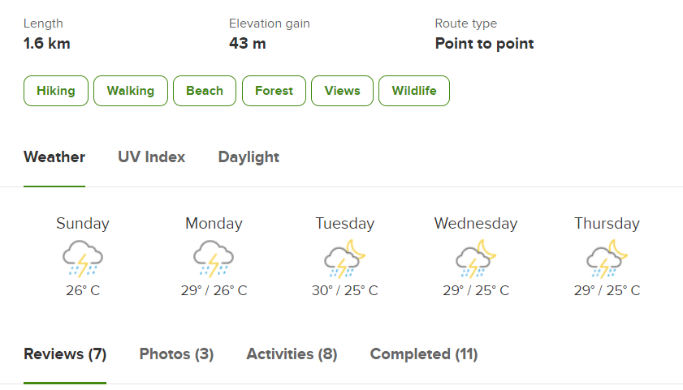
DETAILS/INFORMATION FOR TRAILS

Slide 14
DETAILS/INFORMATION FOR TRAILS

Slide 15
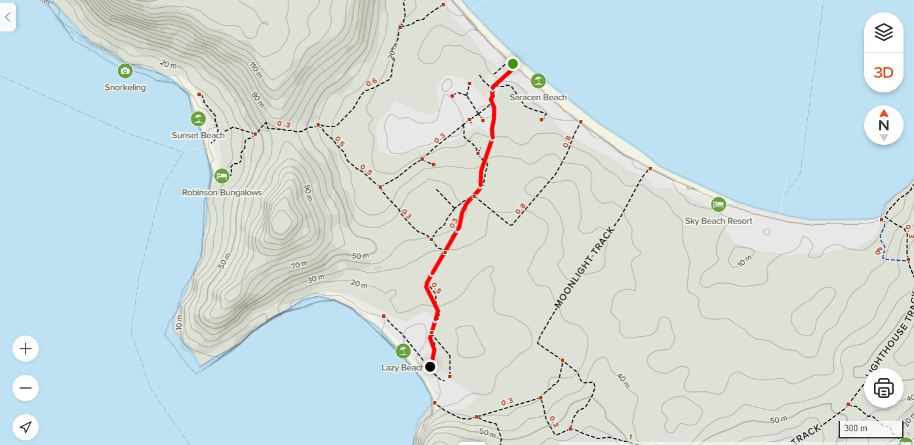
TRAILS MAP/ROUTES

Slide 16
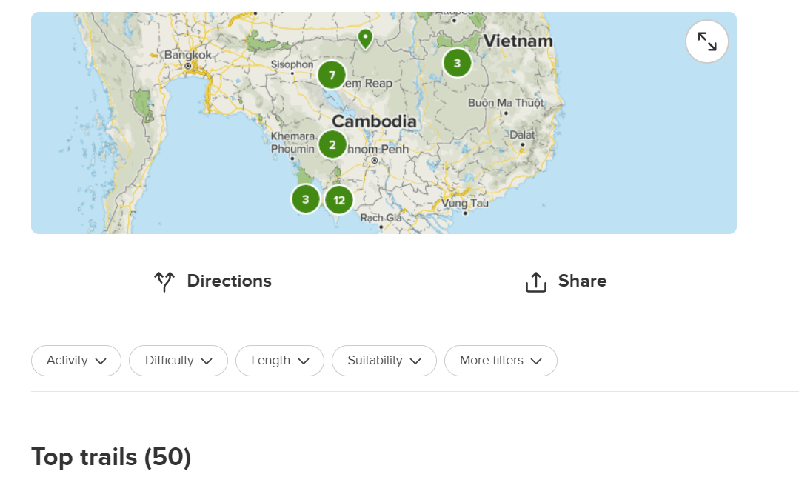
TRAILS SORTING

Slide 17
Thanks!
Any questions?

